Slide 1
The Great Potato Famine
of 1845-1852

Slide 2
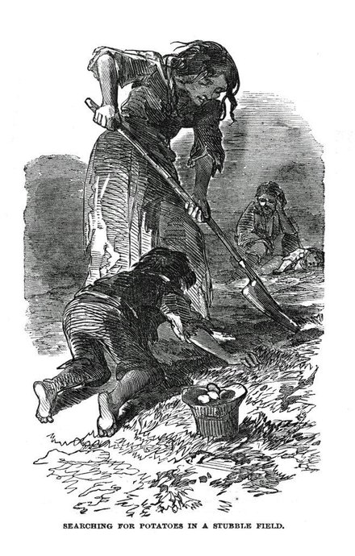

Slide 3
Ireland was ruled by Great Britain during the Great Potato Famine

Slide 4
The country of Great Britain thrived on the free trade principle of profit

Slide 5
Much of Ireland’s lower class was entering into deeper poverty just before the Great Potato Famine

Slide 6
A committee of prominent Irish subjects led by Thomas Drummond surveyed the infrastructure

Slide 7
However, no money was spent on infrastructure projects such as drainage, harbors, or fisheries

Slide 8
The fisheries were undeveloped
Some fishermen could not even buy enough salt to preserve their catch

Slide 9
Ireland at that time had 164 miles of railways
In contrast, England had 6,621 miles of railways

Slide 10
Without knowledge of best farming practices, a developed infrastructure, or proven safety-net for the very poor, Ireland’s tenant farmers were “at-risk”

Slide 11
Ireland’s tenant farmers struggled both to provide for themselves and to supply the British market with cereal crops

Slide 12
The corn, wheat, barley, and oats Irish farmers grew was exported or sold in order to pay their rent

Slide 13
The policy between the land owner, rent collector and tenants stated that tenants that could not pay their rent were quickly evicted

Slide 14
By 1835, three-fourths of Irish workers were unemployed

Slide 15
Unemployed Irish workers turned to planting potatoes to feed their families and pay the rent

Slide 16
Potatoes were a hardy, nutritious, and calorie-dense crop and relatively easy to grow in the soil

Slide 17
The rural poor came to depend almost exclusively on the potato for their diet

Slide 18
1841 Census Report shows about half the families in rural areas lived in mud cabins
Most only owned a stool for furniture

Slide 19
In 1845 Ireland had unusually cool moist weather, in which the blight thrived

Slide 20
Much of that year’s potato crop rotted in the fields

Slide 21
The fungus continued rotting the potatoes in the following years

Slide 22
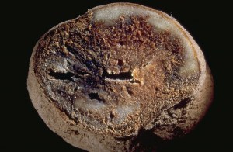
The Potato Blight

Slide 23
The fungus Phytophthora
(Fly-thuh-floor-ruh) infestans
(in-fest-ins) was responsible for the great potato blight that started in 1845

Slide 24
Research shows the mold had its origins in South America during the 16th century
It left Mexico traveling to Ireland in the 1840’s

Slide 25
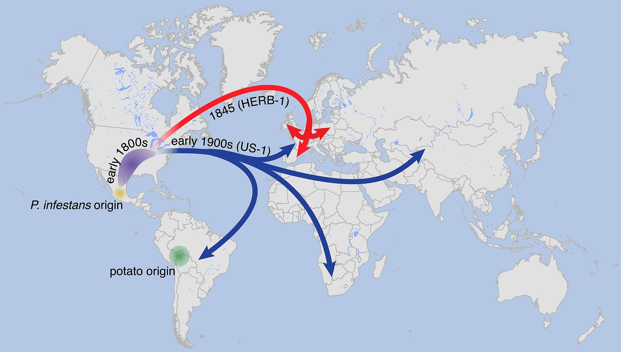
Path of Migration of Potato Blight

Slide 26
By August 1847 as many as three million people were receiving rations at soup kitchens as a result of crop failures

Slide 27
Corn was imported from the United States which helped avert some starvation

Slide 28
The British government’s efforts to relieve the famine were inadequate

Slide 29
It is estimated at least 1 million Irish people died from this famine and related diseases

Slide 30
Another 2 million emigrated from Ireland

Slide 31
Today, Ireland still has not recovered from its pre-famine population level

